Slide 1
Web Services & REST API
Dr. Xueping Li

Slide 2
URLs
Web Dev Roadmap
https://www.w3schools.com/whatis/default.asp
HTML5 (w3schools)
CSS
JAVASCRIPT
BOOTSTRAP
W3.CSS
JQUERY
PHP

Slide 3
In Class Practice

Slide 4
In Class Practice

Slide 5
Set up a web server (software)
Prepare a simple index.html file first.
<!DOCTYPE html> <html> <head> <title>My Web</title> </head> <body> <h1>Welcome to IE421 Class! </h1> </body> </html>
Simply run this command (method #1)
php –S 127.0.0.1:8000
Note that port is 8000 which you can change.

Slide 6
Apache (#2)
> cd
> mkdir web
> cd web
> docker run -d -p 8000:80 --name my-apache-php-app -v "$PWD":/var/www/html php:7.2-apache

Slide 7
PHP SLIM (#3)
> REST API Server
>

Slide 8
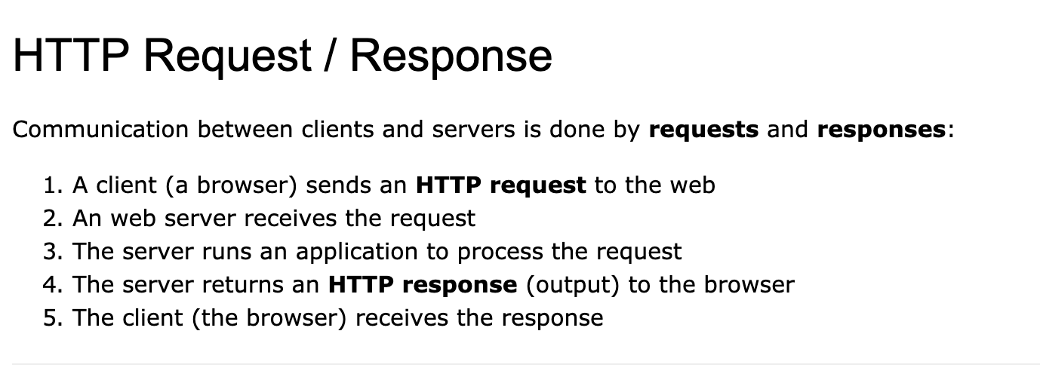
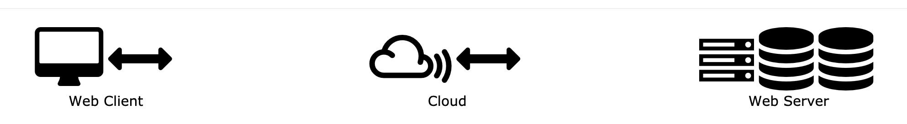
HTTP

Slide 9
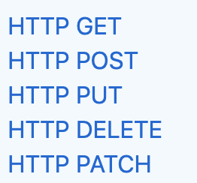
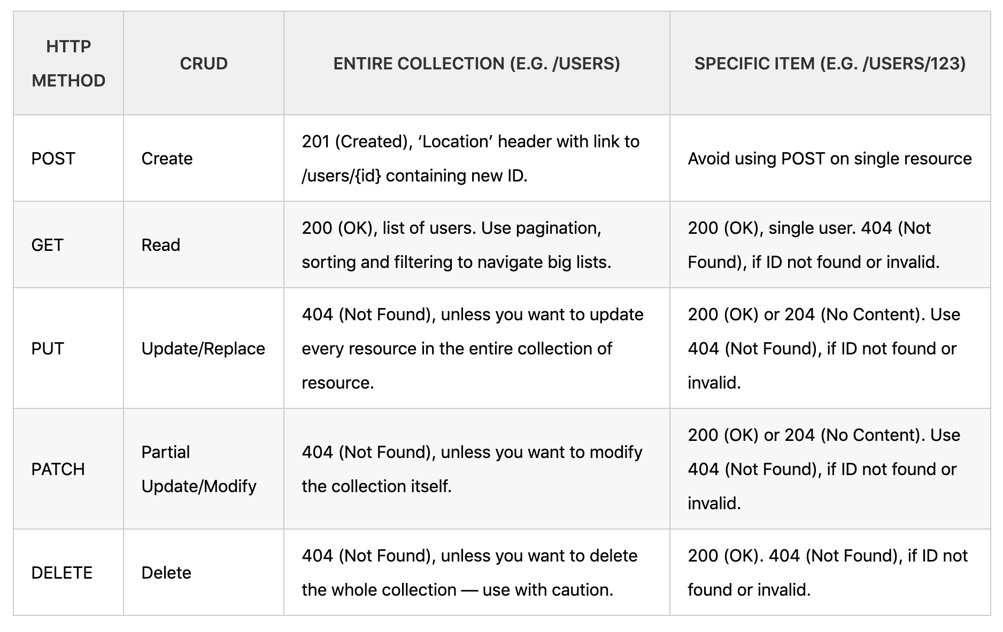
REST
https://spring.io/understanding/REST
REST (Representational State Transfer)

Slide 10
A Simple Contact Me Example
Backend table creation
Front End Form
Backend web services

